Slide 1
Public Action for Public Goods
Banerjee, A.
Iyer, L.
Somanathan, R.
Ali Sheikhpour

Slide 2
Public Action vs Access to Public Goods
Importance: 2-Fold
The National Election Survey (1996, India, n=1000): “what are the three main problems people like you face today”
—Poverty was the most popular response ranked by 1/4
—Public goods close second:
Nearly a fifth of all respondents listed problems associated with forms of public goods (education, drinking water, electricity, transport and communication) as their “main problem”

Slide 3
Empirical Heterogeneity
Banerjee uses aggregate empirical economic disharmony as a unit to make claim…

Slide 4



India Map
The Probe Team (1999)
Center for the Study of Developing Societies (1996)
Madhya Pradesh was defeated in the assembly elections (2003) landslide victory by Bharatiya Janata party “electricity roads and water” campaign mantra
Jammu & KasHmir
Srinagar
JammU
Himachal Pradesh
PunJab
Shimla
Chandigarh
Dehradun
Haryana
UttaraKHand
Sikkim
Arunachal Pradesh
Delhi
Uttar Pradesh
Itanagar
Gangtok
AsSAm
Dispur
Nagaland
Jaipur
Bihar
Kohima
Rajasthan
Lucknow
Patna
Shillong
Meghalaya
Imphal
Gujarat
Jharkhand
Manipur
Bhopal
Ranchi
Agartala
Aizawl
Gandhinagar
Chhattisgarh
Tripura
Mizoram
Madhya Pradesh
Kolkata
West bengal
DAMAN & DIU
Daman
(odisha)
Orissa
Dadra &
nagar Haveli
Silvassa
Maharashtra
Raipur
Bhubaneswar
Mumbai
Telangana
Hyderabad
Goa
Andhra
Pradesh
Panaji
Karnataka
bangalore
Chennai
Kerala
PONdIcherry
Tamil
Nadu
Thiruvananthapuram

Slide 5
Purpose
The empirical variations (cross-country and within-country)… within proven literature demonstrates distribution of public goods at bottom up perspective is inaccurate and instead needs an interplay of “top-down” processes

Slide 6

Indonesia
Poor Communities that have contributed little economically
More viable communities
Higher spending on education

Slide 7
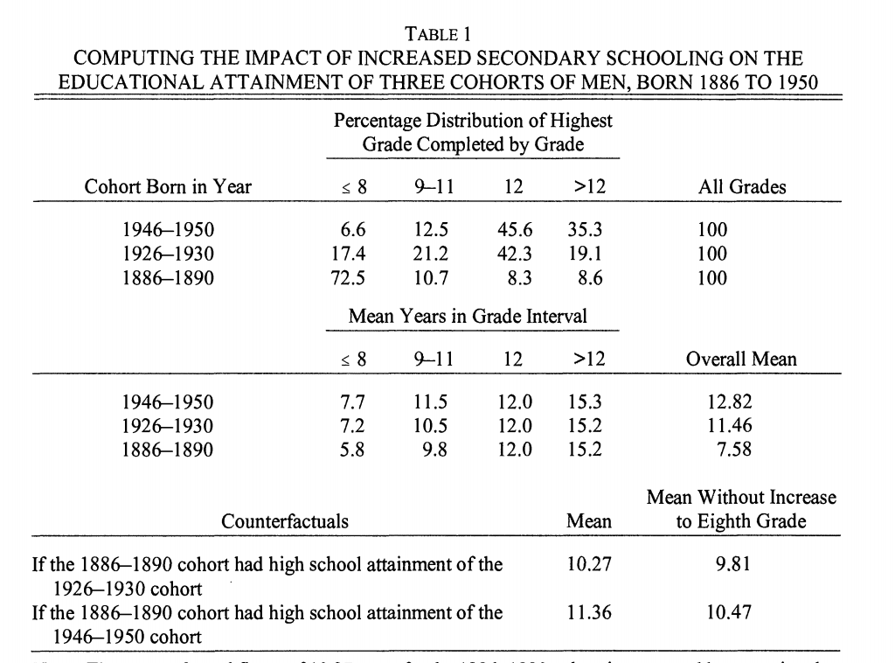
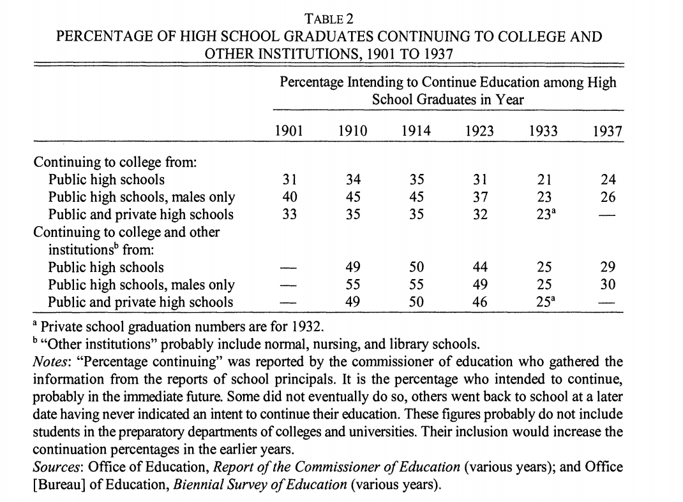
Golden (1998) - Inter-war period 1910-1940 expansion in public schools
Primary reason for entrance growth in high schools was “prelude to college”

Slide 8
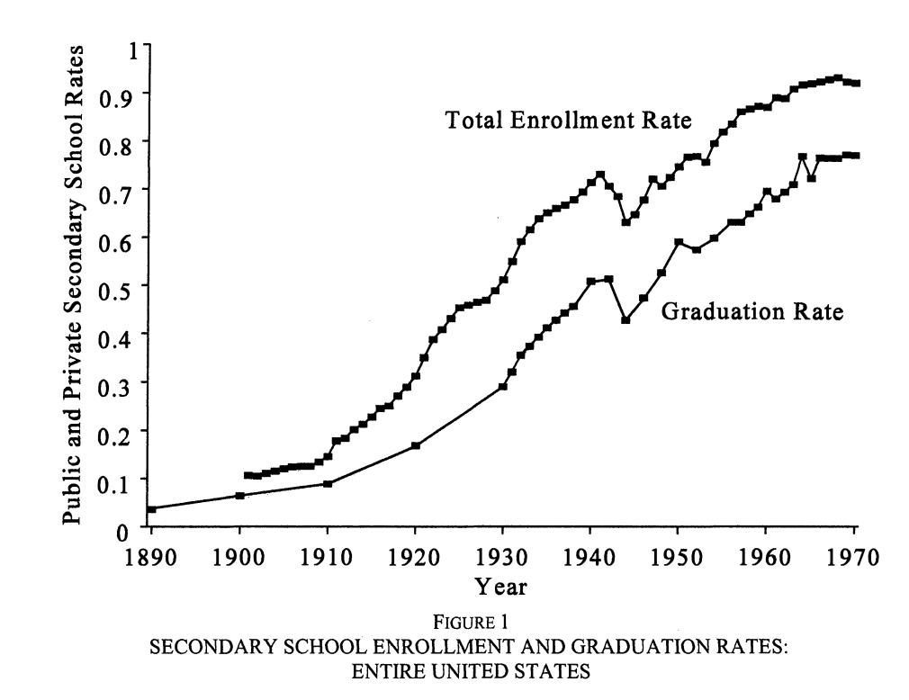
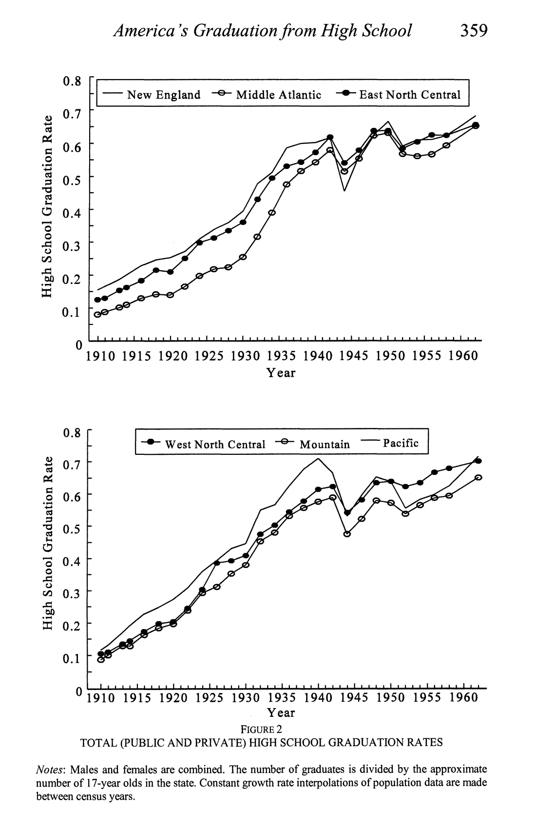
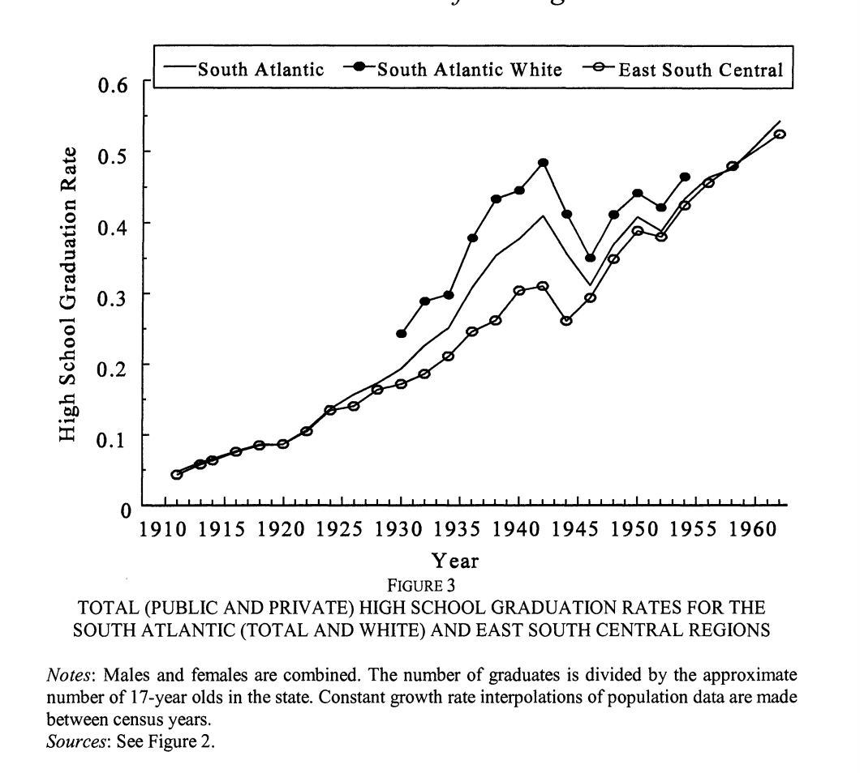
Great Depression/Pre-Depression
Diffusion

Slide 9
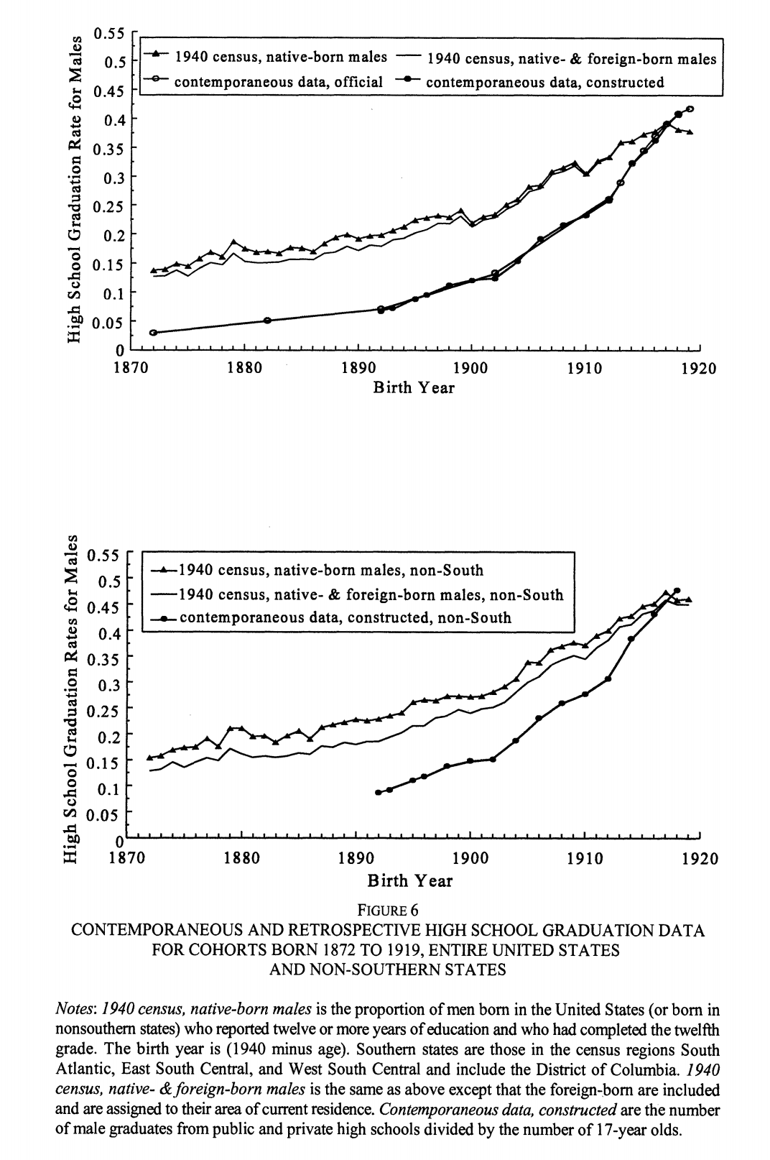
“This increase was uniquely American; no other nation underwent an equivalent change for several decades. States that rapidly expanded their high school enrollments early in the period had greater wealth, more homogeneity of wealth, and less manufacturing activity than others” — Golden
“Neither was as spectacular in its increase as was the rise of the public high school.”

Slide 10
Japan’s growth in literacy first decade 1900-1910 - Sen
Education very quickly seen as a freeing enterprise. Japan swiftly takes heed on lessons
“Between 1906 and 1911, education consumed as much as 43 percent of town and village budgets in Japan as a whole. By the early years of the 20th century, very little illiteracy remained, and indeed by 1913 Japan was publishing almost twice as many books as the United States” (see Gluck 1985) — Sen

Slide 11
NORTH AMERICA
EUROPE
Japan
Largest gaps reside in poorest countries, after controlling for income, variation in access isn’t clear
— “Public goods do not seem to arrive in any particular order as countries get richer”
— Different types of public groups do not “move together”
— Large expansions of public goods in areas that have historically been both economically and politically weak
Unexplained variations when considering “bottom up”…

Slide 12
Cautiously keeps in mind:
“Dearth quality of evidence” and focuses instead on the forces that appear top-down…
“All models are wrong, but some are useful,”
- Box, G.
“econometric models are metaphors providing different windows on a complex and bewildering reality” - Pesaran, H. M.

Slide 13
Methods & Assumptions
Premise: “personal gains earned public good depend on group… but personal costs of participation in group private incurred”
Early literature only: supply —> public goods taxes or community resources (water bodies & forest lands) created and often maintained and monitored by voluntary contributions of labor.
Modern research focus instead on the political competition within groups to ascertain limited goods
“Groups compete to extract public goods from the state.. nature of this competition and the ultimate allocation of public goods varies with group characteristics: their political visibility, their tastes, their size, their potential benefits from public goods, and other social factors that influence their ability to act together.

Slide 14
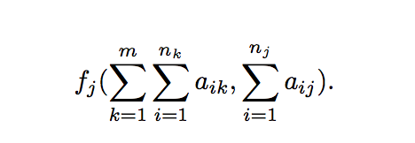
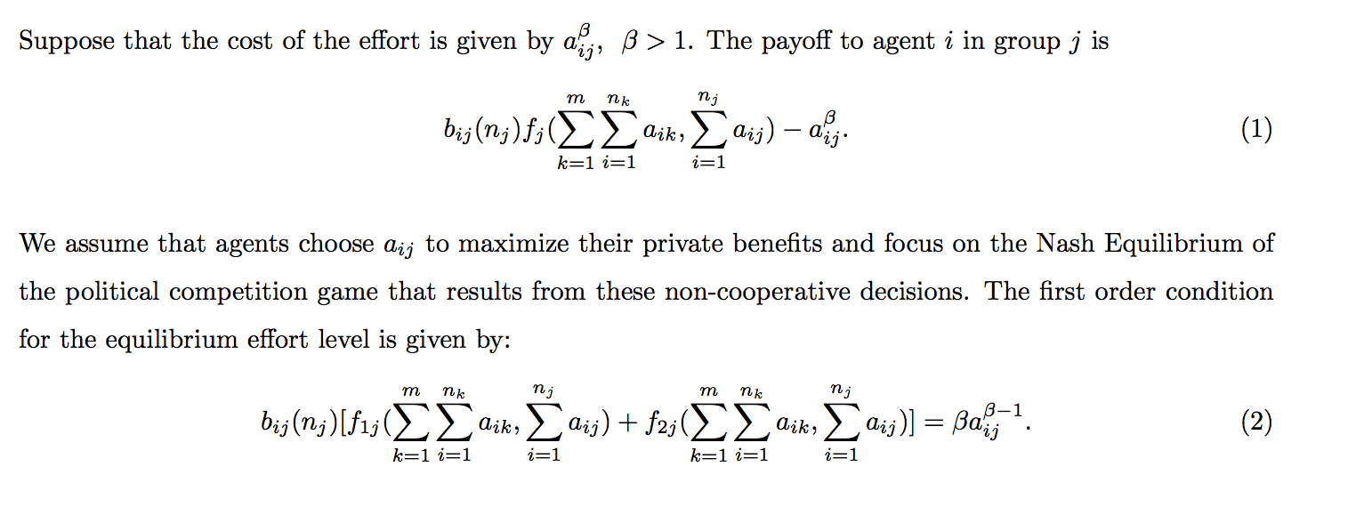
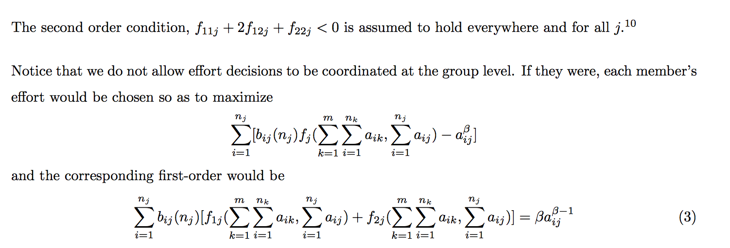

Slide 15
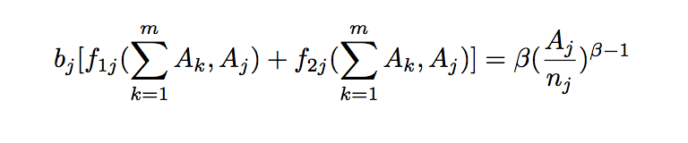
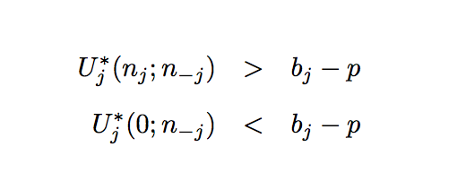
Competition, defection & equilibriums
Free-Riding: “undervaluation of the spillover effects of person effort on other members… thus contributing less than optimal”
Ultimate understanding: desertion

Slide 16
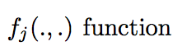
Turns to Power/Influence and Group Characteristics
Disproportionate allocation of power —> size of groups
However institutional history of nation-states changes power equations within model. Western states clearly aimed at shifting powers in favor of working class

Slide 17
Tastes
important presumption that can also change efforts towards public good
Tiebout & Benabou — allow for models “force consumer-voter to state his true preferences” and account spillovers
Migration
Migration in developing countries can be ignored (for sake of model)
This is in itself one of the problems

Slide 18
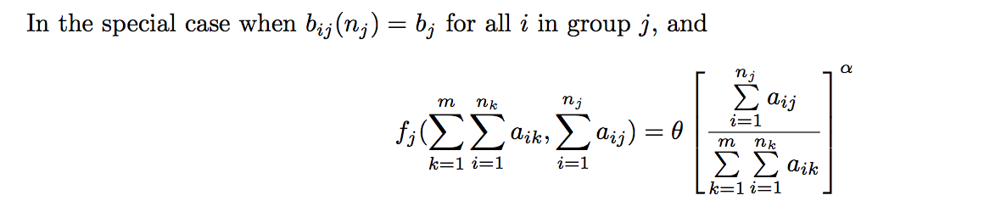
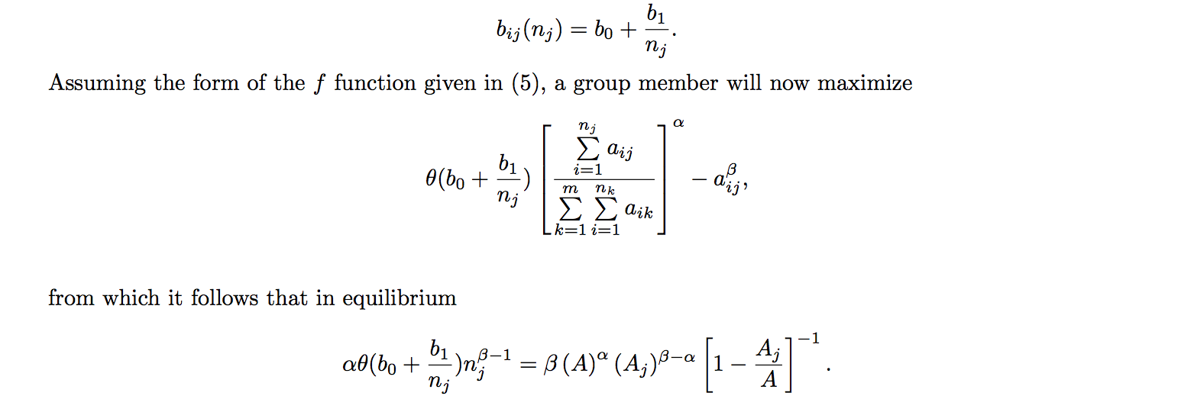
Group Size: Free-Rider more serious

Slide 19
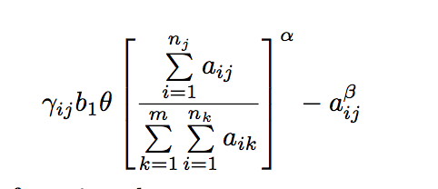
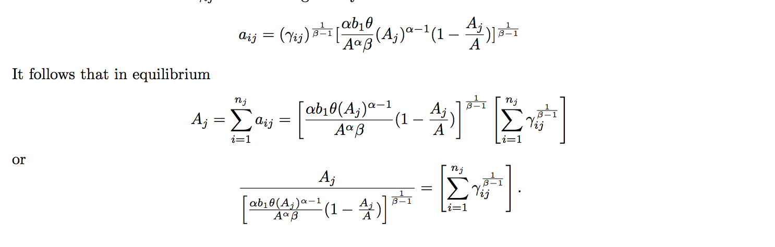
Group Benefits
Those with highest benefits more likely to exit the system —> private market —> ∆ inequality increase
Khwaja (2004) - alternative model aggregate models where convexity of ind. costs decrease

Slide 20
Cohesion (a myriad of approaches)
Alesina, Bar and Easterly, (1999) - may have different preferences
Vigdor (2004) - Altruism to people similar
Miguel and Gugerty (2005) - lack of chohesion may influence provisions —> even in the case of 100% agreement

Slide 21
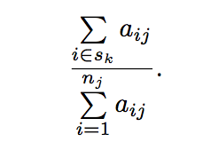
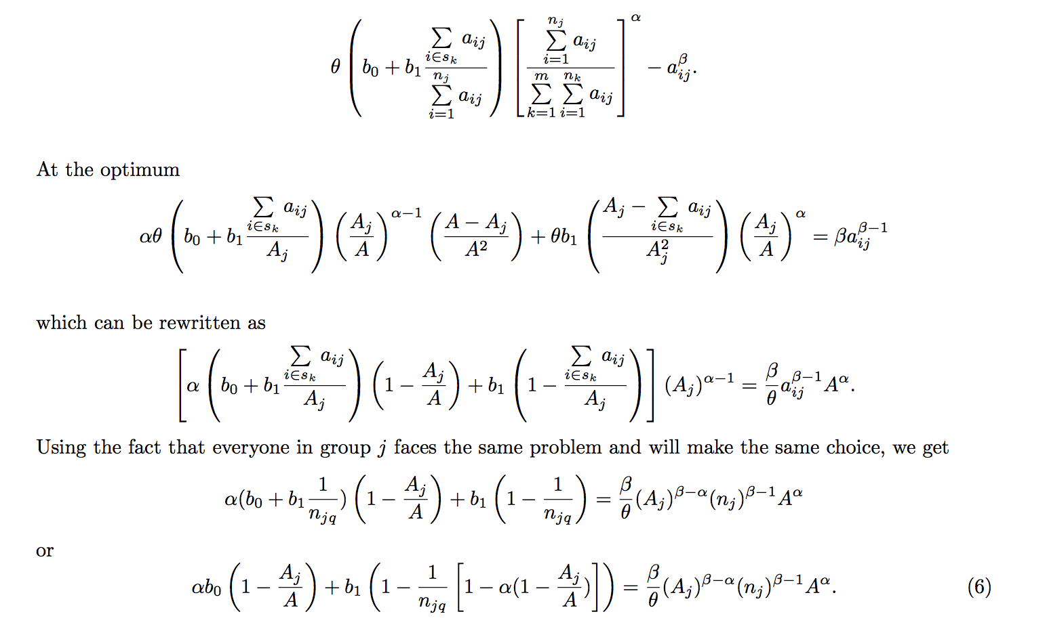
Start with:

Slide 22
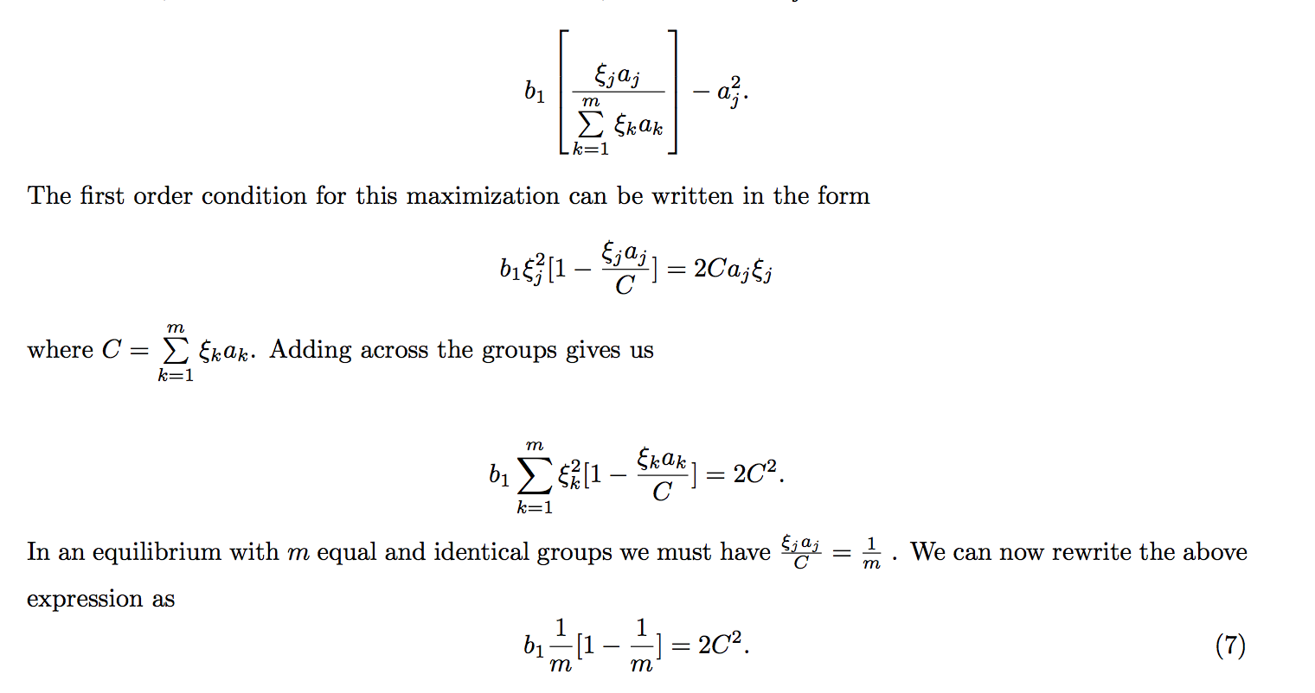
Esteban and Ray (1999)
“More effort reduces quality of the public goods”
— Effort is in form of lobbying

Slide 23
Reflections of Models
When individuals are absent in coordination —> under-supply of effort but extent socially under-provisioned - characteristics

Slide 24
Problems: “Public action never directly exempt in experimental” environments suggest observations instead on public access and availability and relationship in community characteristics
Quality vs Quantity
As Tiebout model - characteristics of community may change in response to availability

Slide 25
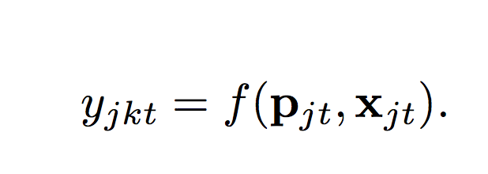
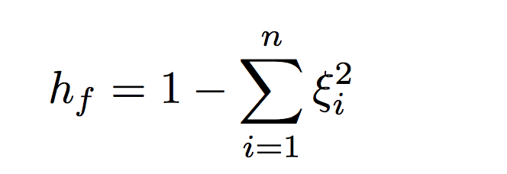
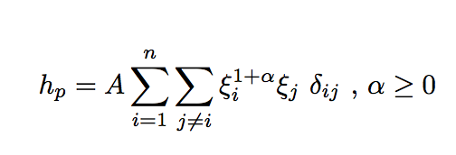
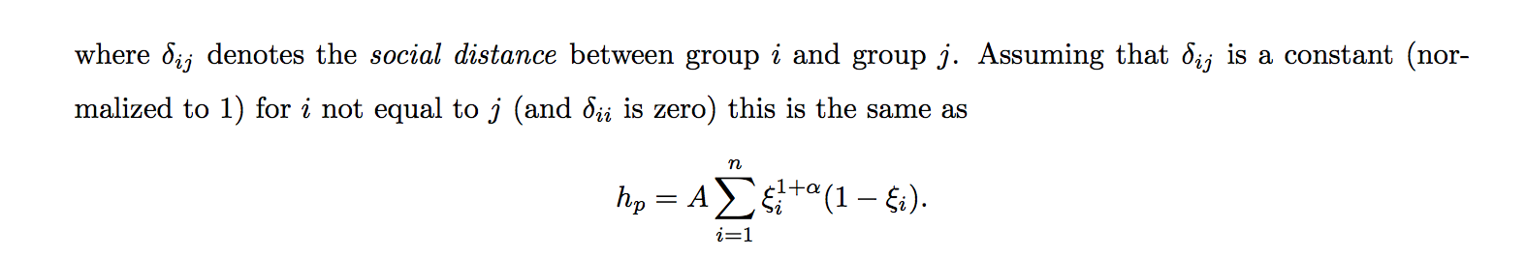
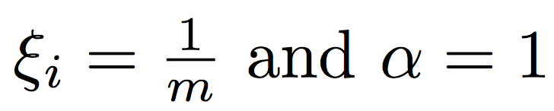
Index of Polarization Relation to Lack of Cohesion
Heterogeneity index of ethnolinguistic fragmentation

Slide 26
Role of Group Characteristics, Distributions of Benefits and Cohesion
Hard to observe
Proxies
Foster and Rosenzweig (2000) - measure returns to public goods —> if availability changes in response to those goods
“India data between 1971-1982 secondary school enrollments and school construction responses to the rapid growth in agricultural yields”
Political sway
Religion

Slide 27
Distribution of Benefits
Khwaja (2002) - “deal with this by separately measuring assets and benefits.
Controlled for inequality in the land, still unequal in benefits —> significant U-shaped effect. “Increases in inequality at low levels of inequality hurts the public projects, but further increases at higher levels of inequality… leads greater maintenance.”
Olsen affect - farmers and free-riding within technological advances in agriculture

Slide 28
Cohesion
Unclear — huge problem of heterogeneity
Interpretation of welfare
Collective action with more groups or wasteful?
“Not clear how one would establish exogeneity of the heterogeneity measure”

Slide 29
Public Goods experiment vary in psychological experiments
Subjects contribute more than expected under Nash equilibrium ~40-60%
Drastic changes with communication within groups that don’t know each other:
“we would expect correlation with the frequency of within-group interactions to explain provision of public good”
Possible that social classifications that we observe in census and survey data not most appropriate as they can quickly change

Slide 30
Costs and Potential Bottom up Interventions
Political leverage
Costs in India 21% higher than social near-optimum allocation (Athreya and Somanathan, 2006)
Rahman and Smith (1999) - Bangladesh relocation of centers would reduce distance 43%
Bureaucratic Mistakes
Turn to autonomous states of India where rulers provide public goods, even lacking in public effort

Slide 31

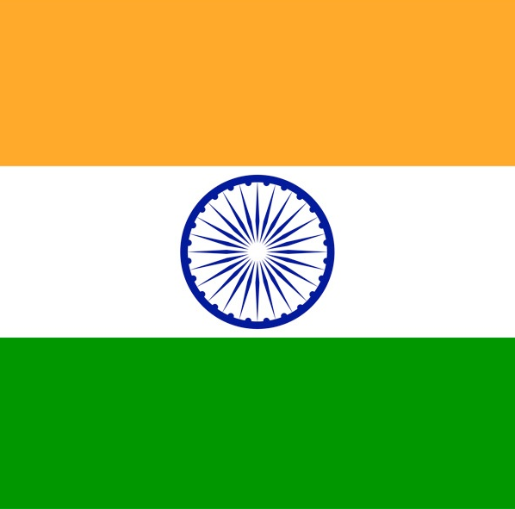

India Map
Jammu & KasHmir
Srinagar
JammU
Himachal Pradesh
PunJab
Shimla
Chandigarh
Dehradun
Haryana
UttaraKHand
Sikkim
Arunachal Pradesh
Delhi
Uttar Pradesh
Itanagar
Gangtok
AsSAm
Dispur
Nagaland
Jaipur
Bihar
Kohima
Rajasthan
Lucknow
Patna
Shillong
Meghalaya
Imphal
Gujarat
Jharkhand
Manipur
Bhopal
Ranchi
Agartala
Aizawl
Gandhinagar
Chhattisgarh
Tripura
Mizoram
Madhya Pradesh
Kolkata
West bengal
DAMAN & DIU
Daman
(odisha)
Orissa
Dadra &
nagar Haveli
Silvassa
Maharashtra
Raipur
Bhubaneswar
Mumbai
“The state should defray the entire cost of the education of its people in order that there might be no backwardness in the spread of enlightenment among them, that by diffusion of education they might become better subjects and public servants and that the reputation of the state might be enhanced thereby.”
Telangana
Hyderabad
Goa
Andhra
Pradesh
Panaji
Karnataka
bangalore
Chennai
Kerala
PONdIcherry
Tamil
Nadu
Thiruvananthapuram

